Slide 1



FULL STACK DEVELOPER
MATRAS
Management of Training System
“Optimizing Training System for
Human Performance
by Digitalization system”
Alvany Maulana
Ahmad Abdurrahman
- MATRAS Team -
DM2260925|BF23-PW
DM2260925|MTN

Slide 2

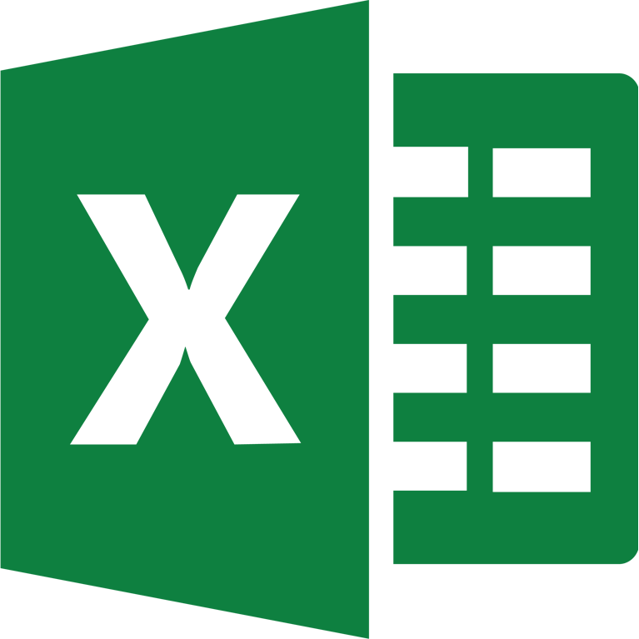












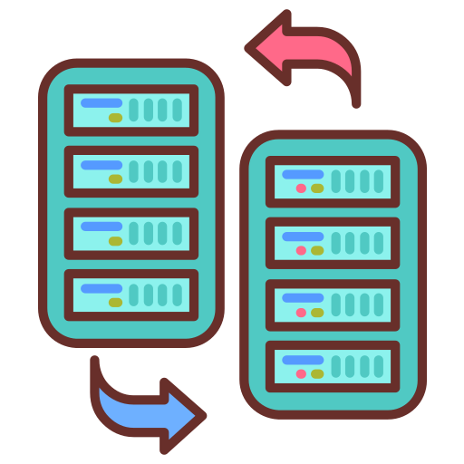







A Smart Transformation in
Management of Training System
HRD
when one process =
5 minutes
Excel
Ms. Form
DOJO PARTICIPANT
Get data from Ms. Form ➔ Copy to Excel ➔ Edit
WOT
CURRENT CONDITION
Transfer participant data by WA Group
10 process worked by input manually
There are
DOJO
TRAINING
Efficient and Effective Management Training
There are participants who double the training.
so it wastes time
- Way Of Thinking
Total Process before improve Need times 15,5 Minutes for 1 Man Power
GOALS
The data input process is still manual so it is not effective
Minimum man hour with effective work and accuracy data.
repeat of sending participant data through to
HR ➔ Muda process
1. Dojo ➔ Result score to HRD
There is no MEIRUKA About Summary data
2. HRD ➔ Data MCU to Dojo
3. Dojo ➔ Distribution Data to HRD
PURPOSE
1
3
4
TARGET
TIMELINE
Create Participant Imports that can detect duplicate participants.
Optimize the training process for more effective time utilization.
We will connect HR and Dojo’s data flow for smoother operations
1
0 duplicate participants who join the training
10-14 july 2023
31-2 august 2023
2
2
Efficiency process of Inputting Data
Prepare
Development
Trial
Presentation
We will set up automatic ways to put in information for accuracy and speed
3
Efficiency work time up to 5 minutes
4
Eliminate Muda process Between HR and Dojo
16-27 july 2023
4 august 2023
ENHANCE OVERALL PRODUCTIVITY BY REDUCING MAN HOURS TO HIGHER-VALUE ACTIVITIES.

Slide 3


























DETAIL SYSTEM
Flow System
Old Flow
Detect Duplicate
Show In Dashboard
DOJO
HRD
Collect personal data by Microsoft form and edit excel manually
Conduct MCU tests And give the results to Dojo by Microsoft teams
DOJO
01
03
DISTRIBUTION
TRAINING
EVALUATION
Dashboard
with Current
Add Batch,
Import Participants
Import All Score
Input IK
& SCW
Send to
Bank Participant
Bank Participant
Distribution
HRD
DOJO
DOJO
Notifies to Dojo new participant by WhatsApp
Manage All Score (Copy, Paste, Edit) in Excel And give to HRD by Email.
Combine Result MCU Tests to summary then input to bank participant file manually (Copy, Paste, and Sort by rank)
Registration user
account with
admin code
Login based on registered
HR
Dashboard with
Current Condition
Export
Result
Update
MCU Result
New Flow
DOJO
HRD
"Accurately assessing
scores from
Microsoft Forms."
Collect personal data by Microsoft form and import to web
Conduct MCU tests And Edit by web if participant failed.
Real time Result
TRAINING
EVALUATION
DISTRIBUTION
"Efficiently managing participant data transfers to participant banks."
Visualization
Pair Programming
HRD
DOJO
DOJO
Notifies to Dojo new participant by WhatsApp
Import All Score from Excel to Web, And monitoring the result directly by HR
All Participants who pass directly enter the participant’s bank.
Vs. Code
Database
Web Server
THE NEW FLOW IS MORE EFFICIENT AND SPEEDS UP THE WORK PROCESS

